Slide 1

Travel route suggestion based on pattern of travel and difficulties
Group members:
Supriti Mondal (CSE-DS/2021/015)
Amrita Mondal(CSE-DS/2021/018)
Sanchita Sarkar(CSE-DS/2021/008)
Siddhartha Shaw(CSE-DS/2021/003)
Guided by:
Mrs. Manali Sarkar

Slide 2

Agenda:
Introduction
Problem Statement
Methodology
Project Output
Conclusion
Future Scope
References

Slide 3
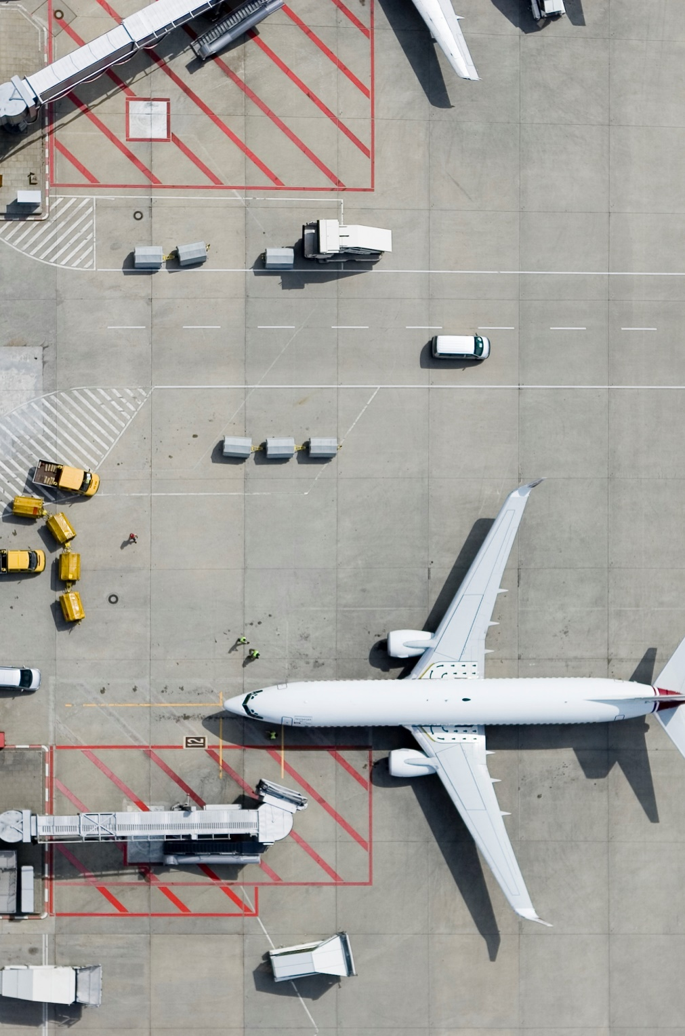
Introduction
This project aims to recommend travel routes based on the user's current or previously visited location.
Clustering algorithms are applied to latitude and longitude coordinates to identify geographically proximate places.
Users provide a specific location, and the system calculates the nearest visited places for optimal route suggestions.
The objective is to enhance travel planning by offering personalized, efficient, data-driven route recommendations.

Slide 4

Problem Statement
Travelers often face difficulties such as traffic condition, route difficulty, and weather conditions when planning routes.
This can be detected using real-time data, user feedback, and travel history, and solved by using algorithms that learn from past traveler experiences to suggest the best and most reliable routes.
The travel recommendation system solves this problem by considering commonly used routes and difficulties faced by past travelers to suggest the most efficient, reliable, and personalized routes.

Slide 5
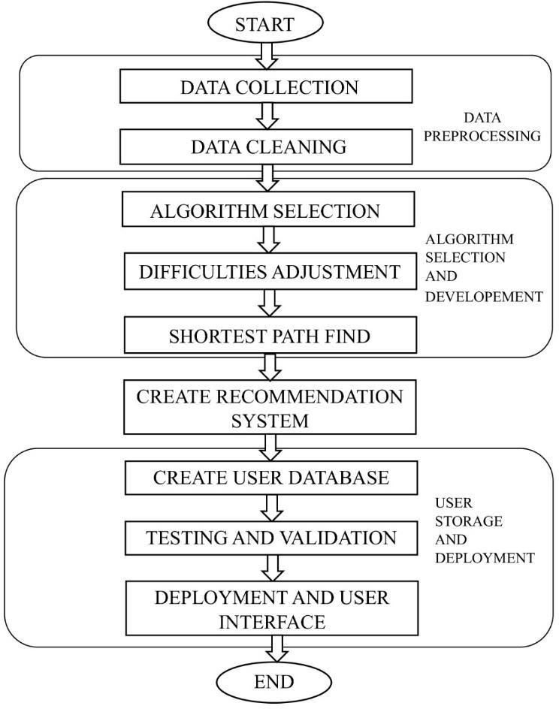
Methodology

Slide 6
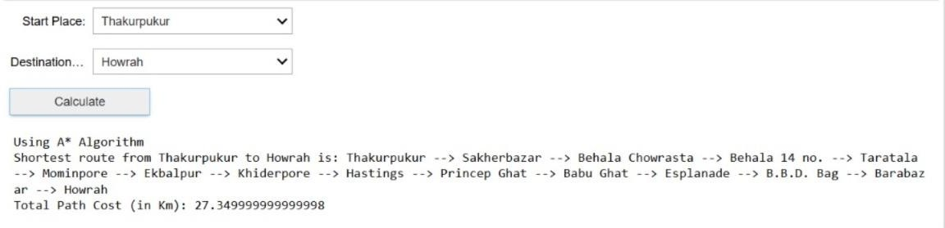
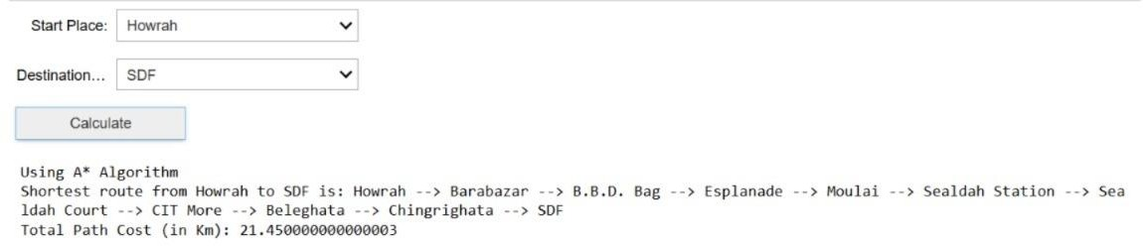
Project Output
Shortest Path

Slide 7
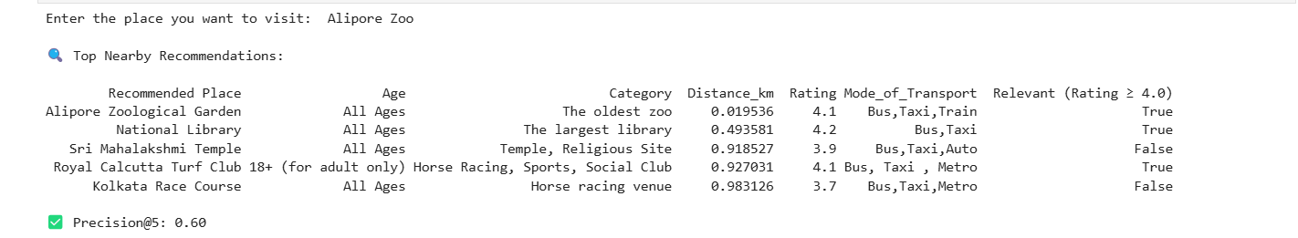
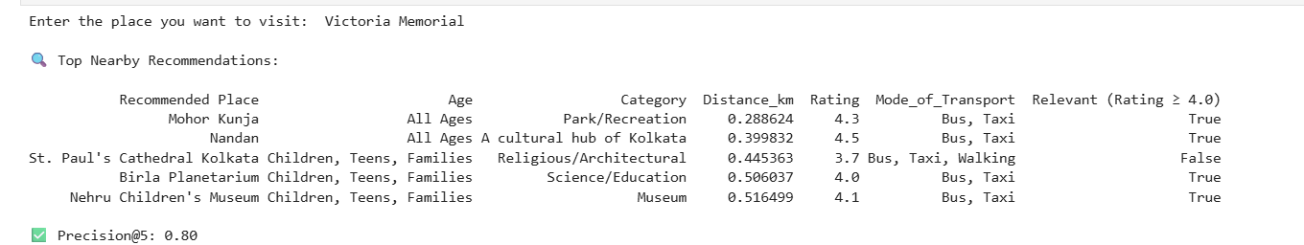
Project Output
Recommendation System

Slide 8

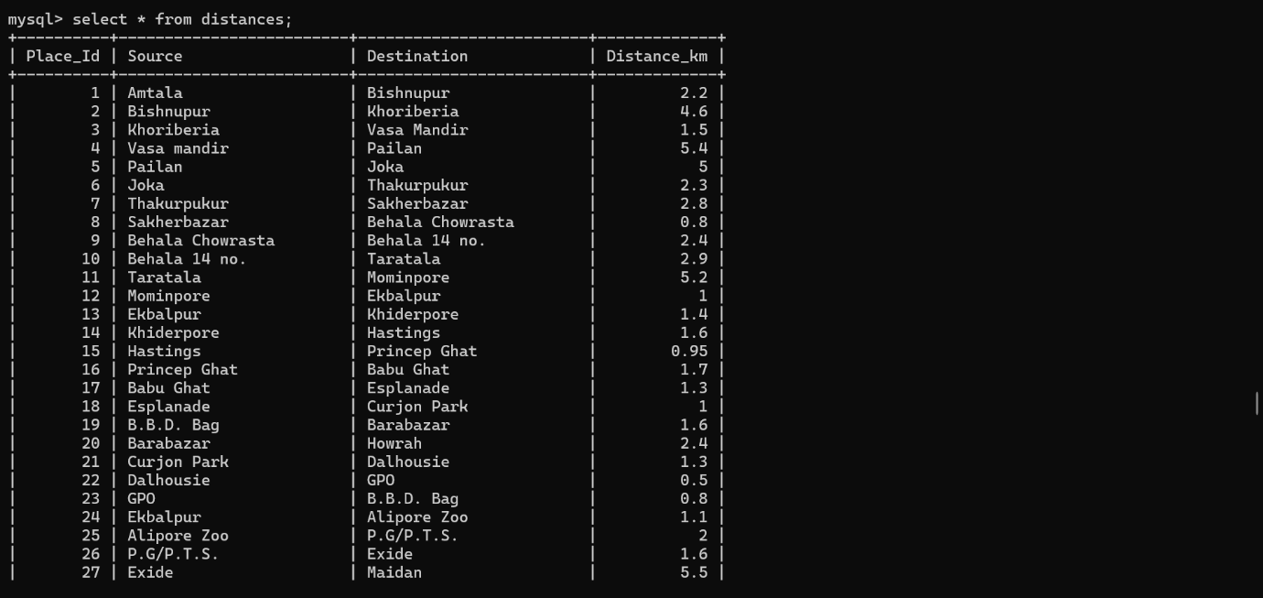
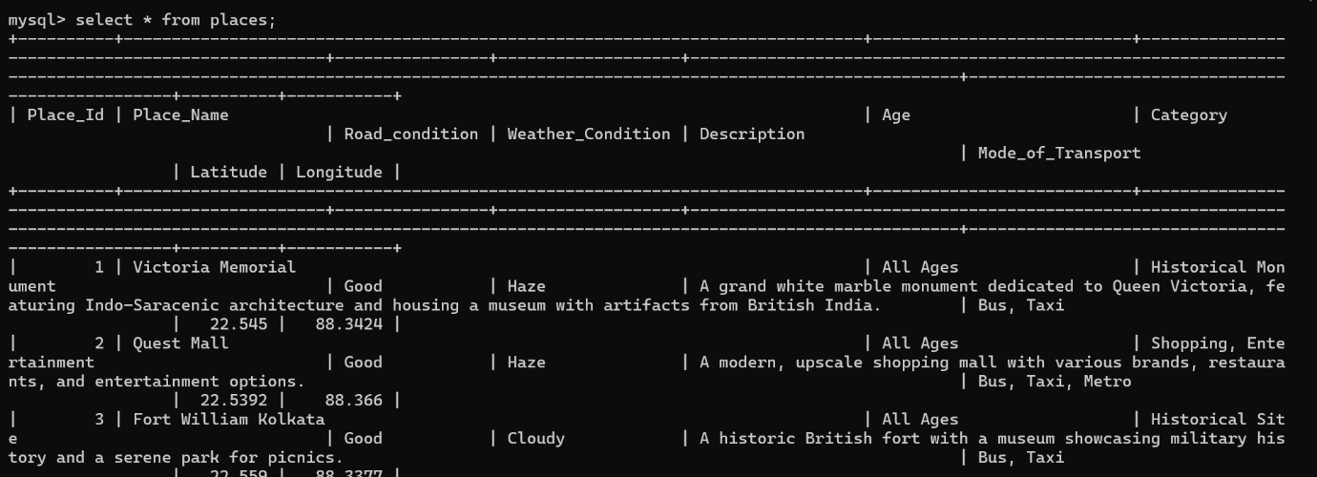
Project Output
Database System

Slide 9
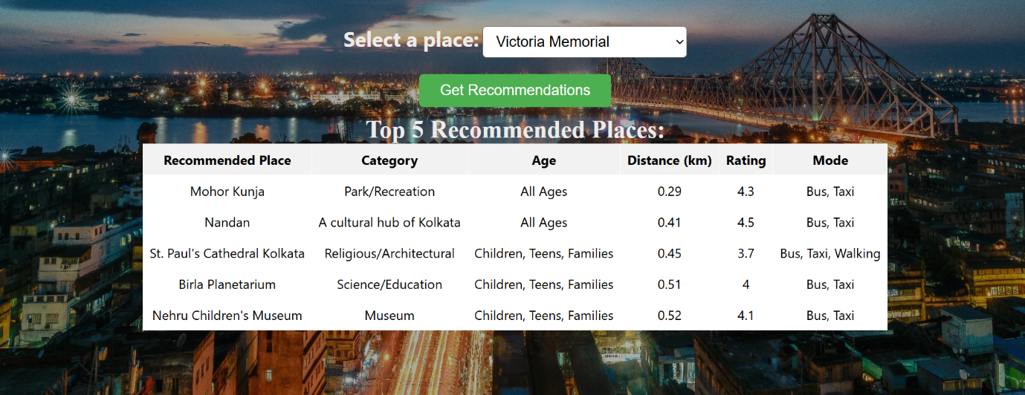
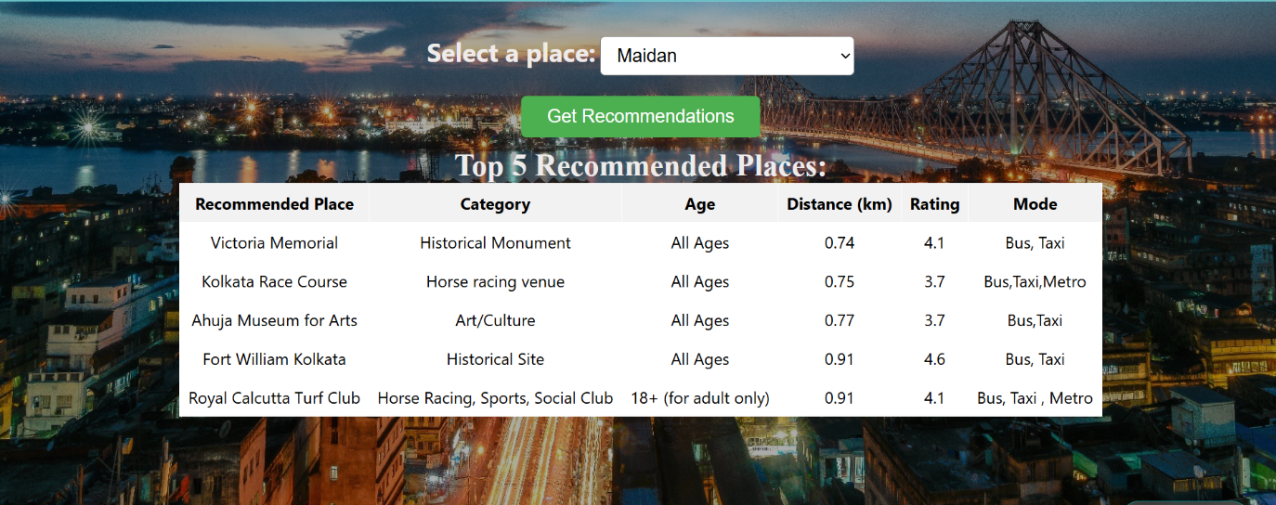
Project Output
Recommendation System(web)

Slide 10
Conclusion
Our project developed a personalized travel recommendation system for tourists in Kolkata.
It uses collaborative filtering to suggest popular nearby destinations based on user searches.
The system helps travelers plan better trips by showing both famous spots and hidden gems.
It also supports local tourism by promoting a variety of attractions.

Slide 11
Future Scope
By implementing a user-friendly web-based application, the travel recommendation system will improve accessibility.
It will integrate real-time data sources and continuously improve by adjusting recommendations based on user satisfaction.
A promising future improvement is adding real-time user feedback to help the system learn and improve continuously.

Slide 12
References
L. Ravi and S. Vairavasundaram, "A collaborative location-based travel recommendation system through enhanced rating prediction for the group of users," Comput. Intell. Neurosci., vol. 2016.
A.-J. Cheng, Y.-Y. Chen, Y.-T. Huang, W. H. Hsu, and H.-Y. M. Liao, “Personalized travel recommendation by mining people attributes from community-contributed photos,” Dept. of Computer Science and Information Engineering, National Taiwan University, Taipei, Taiwan, and Institute of Information Science, Academia Sinica, Taipei, Taiwan.
N. Pulmamidi, R. Aluvalu, and V.U. Maheswari, "Intelligent travel route suggestion system based on pattern of travel and difficulties," IOP Conf. Ser.: Mater. Sci. Eng., vol. 1042, 2020.

Slide 13

Thank You.

Slide 14
Any Question?

